Slide 1



APEX INSTITUTE OF TECHNOLOGY
DEPARTMENT OF COMPUTER SCIENCE & ENGINEERING
Database Management System (22CSH-243)
Faculty: Ms. Shaveta Jain (13464)
Database Recovery
DISCOVER . LEARN . EMPOWER

Slide 2
DBMS: Course Objectives
COURSE OBJECTIVES
The Course aims to:
Understand database system concepts and design databases for different applications and to acquire the knowledge on DBMS and RDBMS.
Implement and understand different types of DDL, DML and DCL statements.
Understand transaction concepts related to databases and recovery/backup techniques required for the proper storage of data.

Slide 3
COURSE OUTCOMES
On completion of this course, the students shall be able to:-
CO5 | Understand the concept of transaction processing and concurrency control

Slide 4
Database Recovery of database
Focusing on Recovery:
All database reads/writes are within a transaction
Transactions have the “ACID” properties
  Atomicity - all or nothing
  Consistency - preserves database integrity
  Isolation - execute as if they were run alone
  Durability - results aren’t lost by a failure
Recovery subsystem guarantees A & D
Concurrency control guarantees I
Application program guarantees C

Slide 5
Database Recovery of database
What Makes Transaction Processing (TP) Hard?
Atomicity - no partial results
Isolation – appears to run transactions serially
Durability – results aren’t lost by a failure
Availability - system must be up all the time
Reliability - system should rarely fail
Response time - within 1-2 seconds
Throughput - thousands of transactions/second
Scalability - start small, ramp up to Internet-scale
Configurability - for above requirements + low cost
Distribution - of users and data

Slide 6
Database Recovery of database
Crash
System crash
Transaction error
System error
Local error
Disk failure
Catastrophe
T1
T2
T3
Time
ACID properties of Transaction
Database system should guarantee
Durability : Applied changes by transactions must not be lost. ~ T3
Atomicity : Transactions can be aborted. ~ T1, T2

Slide 7
Database Recovery of database
Checkpoint
System Log
- keeps info of changes applied by transactions
Backup
T1
Crash
T2
T3
Time
Undo/Redo by the Log
→ recover Non-catastrophic failure
Full DB Backup
> Differential Backup
> (Transaction) Log
Catastrophic failure

Slide 8
Database Recovery
Database recovery is the process of restoring the database to the most recent consistent state that existed just before the failure.
Three states of database recovery:
  Pre-condition: At any given point in time the database is in a consistent state.
  Condition: Occurs some kind of system failure.
  Post-condition: Restore the database to the consistent state that existed before the failure
Example:
  If the system crashes before a fund transfer transaction completes its execution, then either one or both accounts may have incorrect value. Thus, the database must be restored to the state before the transaction modified any of the accounts.

Slide 9
Outline
Databases Recovery
1 Purpose of Database Recovery
2 Types of Failure
3 Transaction Log
4 Data Updates
5 Data Caching
6 Transaction Roll-back (Undo) and Roll-Forward
7 Checkpointing
8 Recovery schemes
9 ARIES Recovery Scheme
10 Recovery in Multidatabase System
Chapter 19-<number>

Slide 10
Database Recovery
1 Purpose of Database Recovery
    To bring the database into the last consistent state, which existed prior to the failure.
    To preserve transaction properties (Atomicity, Consistency, Isolation and Durability).
  Example: If the system crashes before a fund transfer transaction completes its execution, then either one or both accounts may have incorrect value. Thus, the database must be restored to the state before the transaction modified any of the accounts.
Chapter 19-<number>

Slide 11
Database Recovery
2 Types of Failure
  The database may become unavailable for use due to
  Transaction failure: Transactions may fail because of incorrect input, deadlock, incorrect synchronization.
  System failure: System may fail because of addressing error, application error, operating system fault, RAM failure, etc.
  Media failure: Disk head crash, power disruption, etc.
Chapter 19-<number>

Slide 12
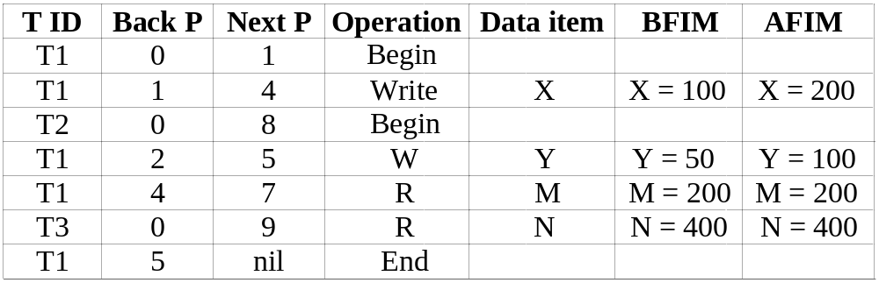
Database Recovery
3 Transaction Log
  For recovery from any type of failure data values prior to modification (BFIM - BeFore Image) and the new value after modification (AFIM – AFter Image) are required. These values and other information is stored in a sequential file called Transaction log. A sample log is given below. Back P and Next P point to the previous and next log records of the same transaction.
Chapter 19-<number>

Slide 13
Database Recovery
4 Data Update
  Immediate Update: As soon as a data item is modified in cache, the disk copy is updated.
  Deferred Update: All modified data items in the cache is written either after a transaction ends its execution or after a fixed number of transactions have completed their execution.
  Shadow update: The modified version of a data item does not overwrite its disk copy but is written at a separate disk location.
  In-place update: The disk version of the data item is overwritten by the cache version.
Chapter 19-<number>

Slide 14
Database Recovery
5 Data Caching
  Data items to be modified are first stored into database cache by the Cache Manager (CM) and after modification they are flushed (written) to the disk. The flushing is controlled by Modified and Pin-Unpin bits.
  Pin-Unpin: Instructs the operating system not to flush the data item.
  Modified: Indicates the AFIM of the data item.
Chapter 19-<number>

Slide 15
Database Recovery
6 Transaction Roll-back (Undo) and Roll-Forward (Redo)
  To maintain atomicity, a transaction’s operations are redone or undone.
  Undo: Restore all BFIMs on to disk (Remove all AFIMs).
  Redo: Restore all AFIMs on to disk.
  Database recovery is achieved either by performing only Undos or only Redos or by a combination of the two. These operations are recorded in the log as they happen.
Chapter 19-<number>

Slide 16
Database Recovery
Roll-back
We show the process of roll-back with the help of the following three transactions T1, and T2 and T3.
  T1 T2 T3
  read_item (A) read_item (B) read_item (C)
  read_item (D) write_item (B) write_item (B)
  write_item (D) read_item (D) read_item (A)
  write_item (A) write_item (A)
Chapter 19-<number>

Slide 17
Database Recovery
Roll-back: One execution of T1, T2 and T3 as recorded in the log.
A B C D
30 15 40 20
  [start_transaction, T3]
  [read_item, T3, C]
  * [write_item, T3, B, 15, 12] 12
  [start_transaction,T2]
  [read_item, T2, B]
  ** [write_item, T2, B, 12, 18] 18
  [start_transaction,T1]
  [read_item, T1, A]
  [read_item, T1, D]
  [write_item, T1, D, 20, 25] 25
  [read_item, T2, D]
  ** [write_item, T2, D, 25, 26] 26
  [read_item, T3, A]
  ---- system crash ----
  * T3 is rolled back because it did not reach its commit point.
  ** T2 is rolled back because it reads the value of item B written by T3.
Chapter 19-<number>

Slide 18
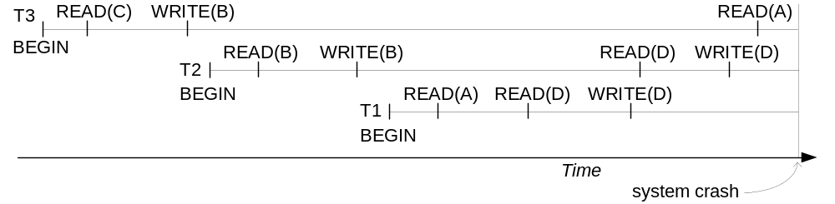
Database Recovery
Roll-back: One execution of T1, T2 and T3 as recorded in the log.
Illustrating cascading roll-back
Chapter 19-<number>

Slide 19
Database Recovery
Write-Ahead Logging
  When in-place update (immediate or deferred) is used then log is necessary for recovery and it must be available to recovery manager. This is achieved by Write-Ahead Logging (WAL) protocol. WAL states that
  For Undo: Before a data item’s AFIM is flushed to the database disk (overwriting the BFIM) its BFIM must be written to the log and the log must be saved on a stable store (log disk).
  For Redo: Before a transaction executes its commit operation, all its AFIMs must be written to the log and the log must be saved on a stable store.
Chapter 19-<number>

Slide 20
Database Recovery
7 Checkpointing
  Time to time (randomly or under some criteria) the database flushes its buffer to database disk to minimize the task of recovery. The following steps defines a checkpoint operation:
  Suspend execution of transactions temporarily.
  Force write modified buffer data to disk.
  Write a [checkpoint] record to the log, save the log to disk.
  Resume normal transaction execution.
  During recovery redo or undo is required to transactions appearing after [checkpoint] record.
Chapter 19-<number>

Slide 21
References
RamezElmasri and Shamkant B. Navathe, “Fundamentals of Database System”, The Benjamin / Cummings Publishing Co.
Korth and Silberschatz Abraham, “Database System Concepts”, McGraw Hall.
C.J.Date, “An Introduction to Database Systems”, Addison Wesley.
Thomas M. Connolly, Carolyn & E. Begg, “Database Systems: A Practical Approach to Design, Implementation and Management”, 5/E, University of Paisley, Addison-Wesley.

Slide 22

THANK YOU
For queries
Email:shaveta.e13464@cumail.in

